Slide 1

DABUGGERS MAZE
Logan Earl
Pavel Trubchik
Svetlana Kozubenko

Slide 2
MVC Architecture
View and Controller are dedicated interfaces with flexible implementations
Controller consists mainly of GameEvent objects, these objects are part of the Controller package and encapsulate actions the player could make.
View is instantiated with a GameEventListener that is fed GameEvents as the player makes them.
Controller contains references to everything and decides which world and view to resolve GameEvents against.
Notes:
View and Controller are dedicated interfaces with flexible implementations This makes unit testing easier as you can swap items that aren’t being tested with dummy objects
Controller consists mainly of GameEvent objects, these objects are part of the Controller package and encapsulate actions the player could make. This is an example of the strategy pattern. Each GameEvent is a piece of functionality. The view does not know how they work or what they do, only which ones to create. For that matter, neither does the controller implementation. The controllers only job is to hold references to everything and feed the GameEvents the info they need to operate
View is instantiated with a GameEventListener that is fed GameEvents as the player makes them. That way the view doesn’t even have to rely on a controller implementation. Literally all it does is just create GameEvents and shove them in the appropriate direction
Controller contains references to everything and decides which world and view to resolve GameEvents against. In our current implementation we only have one world active at a time, so this is mostly just added flexibility, but this does make sure that the view doesn’t need references to the World or database stuff. The controller feeds the GameEvents the data and the View creates them

Slide 3
View
Consists of multiple Panels, each representing a “View” the player might be interacting with
Graphics Panel
Main Menu Panel
Save Selector Panel
Etc.
The main view class has references to the available panels. GameEvents (part of the controller) determine which panels are shown and when they are hidden
Panels can have limited communication with each other using an observer-like interface.
Notes:
Pavel’s Slide:
The View consists of multiple Panels, each representing a “View” the player might be interacting with For an example, you might have a Graphics panel the displays your maze, lets the player zoom in and out, etc. But when the player tries to go through a door, the view doesn’t pull up the question view directly. Instead it makes an AccessDoorEvent, passes it to the GameEventListener and waits. The AccessDoorEvent, being a controller class, goes and gets the question, feeds it to the UI and shows the question answer panel. Very decoupled

Slide 4
Controller
Consists of a central Controller implementation and a series of GameEvents.
Controller has references to the following
The View
The GameEventListener (often implemented by the concrete controller, but not necessarily)
The World (model)
The QuestionDataSource (more on that later)
Notes:
Pavel’s Slide
The “Controller” in the MVC structure consists of an actual Controller implementation and a lot of GameEvent implementations. It serves as a sort of central command, keeping references to all the different parts and coordinating access to game and view objects through it.
In our case the game objects and the source of questions are different entities. This added decoupling allows us to do some cool stuff when saving data but more on that in a bit

Slide 5
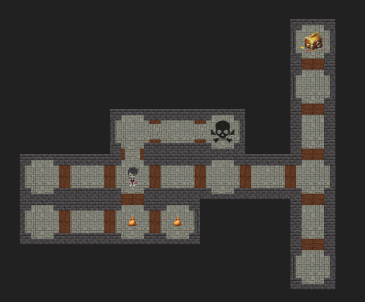
World
The World consists of
A Player
A Set of rooms
Organized via connections to other rooms in a 2d graph
Doors connect rooms, and Doors have questions attached
An entry and exit Room
Worlds are all procedural, allowing for a varied and interesting user experience
Notes:
The world is basically a 2d graph implementation. We decided to forgo the standard 2d array in favor of a more flexible world design. Turns out world generation is hard, and we paid for that at times but it all seems to work in the end. There are any number of rooms in a world, each with a Map<Direction, Door> to store room connections in. Doors are simply a pair of rooms with a question attached so nothing complex there. Once you have your graph of rooms, all you need is a reference to the start room, the end room, and a Player object you’ve got what you need.
Doors can be opened one of 3 ways. Either you get the answer to the riddle right, you find an item that goes to the door and use it, or you find a general use SkeletonKey object that can open any door once. I suppose you can also cheat and use a master Key but lets not count that.

Slide 6
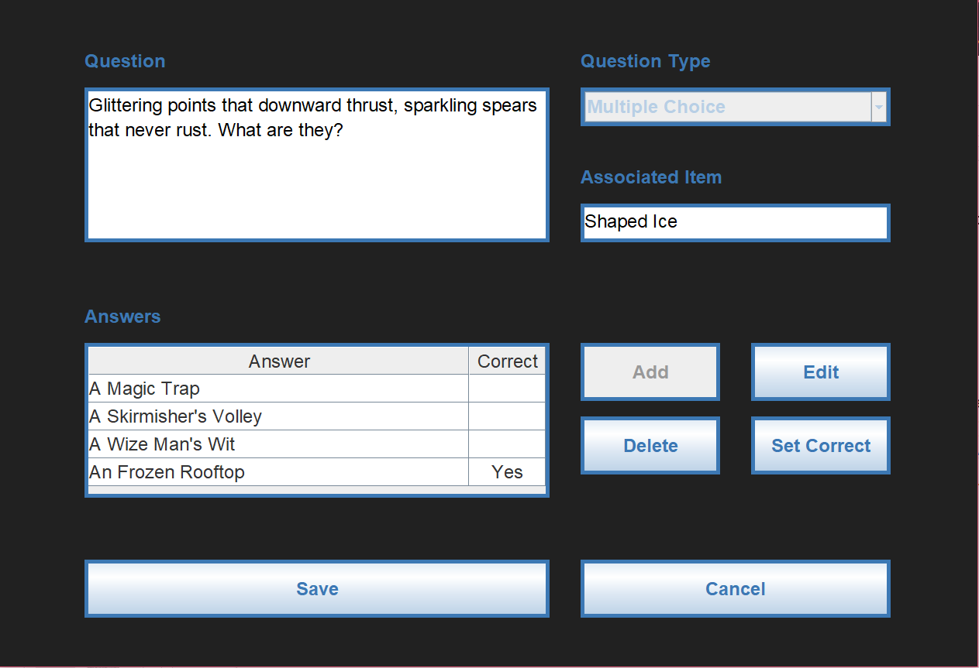
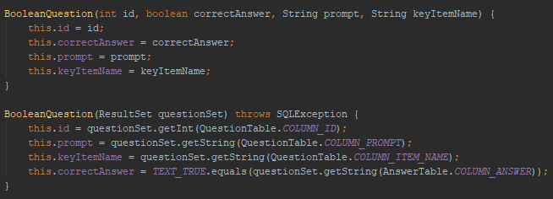
Question DataSource
Interface is designed to allow for multiple implementations of the DataSource, which helps with writing tests.
The Controller concrete implementation uses the SQLiteQuestionDataSource implementation.
Questions are created via a SQLiteQuestionFactory that knows how to parse questions from an SQLite ResultSet object through the utilization of package-private constructors in each SQLiteQuestion implementation.
Notes:
The QuesitonDataSource interface is how questions are stored. The source code only has one implementation of it, that being the SQLiteQuestionDataSource that uses the interface to access a database, but we have several stubbed-out versions for unit testing purposes. One is literally just an array of Questions behind the scenes, which means that the Question tests don’t require working SQL code to operate.
Because we have several types of questions that are all made from the same format of database entry, we need a factory to get the correct object out of it. As you can see each SQLiteQuestion implementation comes with a package-private constructor that knows how to create it from a ResultSet object. This makes parsing them wholly dependent on the implementation, and also makes the Factory object like 10 lines of code. Very nice

Slide 7
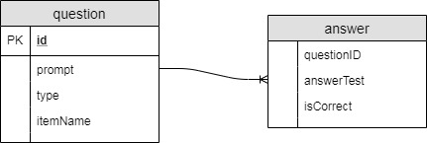
Database Schema
Two total tables
Question
Unique question id
Things like a prompt, question type, etc
An item name, used by random gen if it needs an item that is thematically consistent item for a door
Answer
Many to one relationship with question through unique identifier
The answer in text form
A T/F flag to make the answer correct or incorrect
In the case of short response questions, each answer is a keyword that their answer is checked for
Notes:
Svetlana’s Slide:
To finish it up we have our database schema. This is pretty simple stuff. Each question has a unique identifier, a prompt, a question type string, and an item name. Item names are all thematically consistent with the question prompt, and because there can only be one item for each door it made sense for them to be in the same table. There are also SkeletonKeys that answer all questions but that was done in code, no SQL needed.
There is also a many to one relationship from answers to questions. Some questions such as True/False questions need only a single answer entry, while some, like short response, have quite a few.

Slide 8
